Slide 1





2025 RDKit UGM Boston @ BMS
#StandWithUkraine
AIMNet2: Foundation neural network potential for molecules, reactions and CADD related tasks
Olexandr Isayev
Department of Chemistry, Carnegie Mellon University
olexandr@olexandrisayev.com
http://olexandrisayev.com
@olexandr
Notes:
1

Slide 2
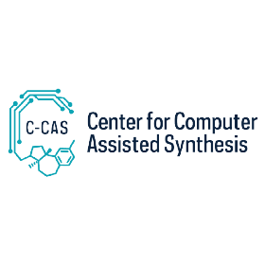

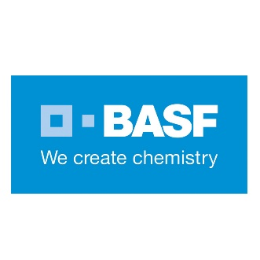





Postdocs:
Dylan Anstine
Peikun Zheng
Bhupalee Kalita
Tanya Zubatiuk
Hatice Gokcan
PhDs:
Phil Gusev
Polina Avdiunina
Ilkwon Cho
Nick Gao
Zhen (Jack) Liu
Filipp Nikitin
Shuhao Zhang
Emma Bouchard
Isayev Lab circa 2024
Funding:
ONR MURI
N00014-21-1-2476
NSF CCI C-CAS
CHE-2154447

Slide 3
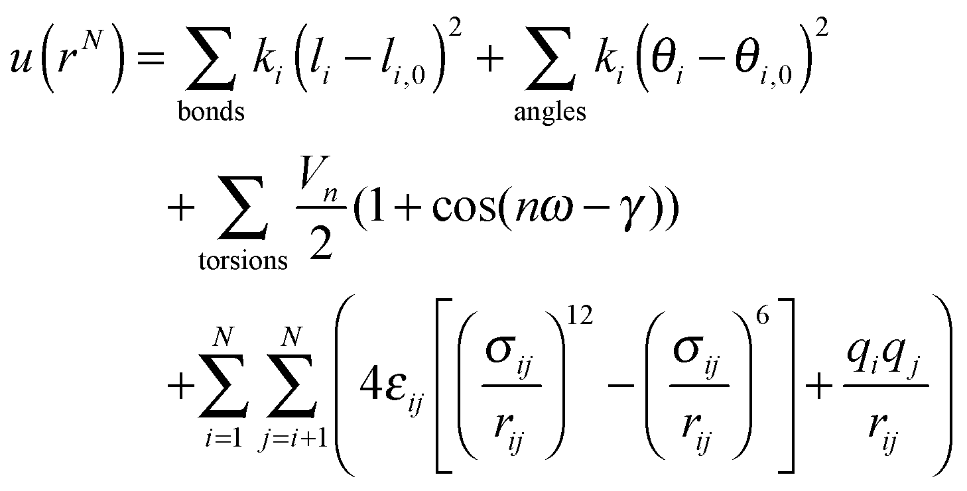
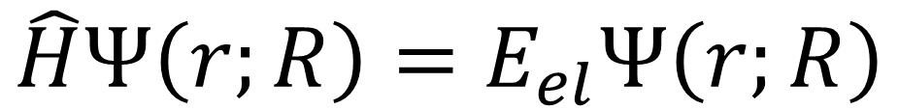
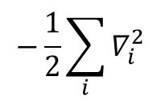
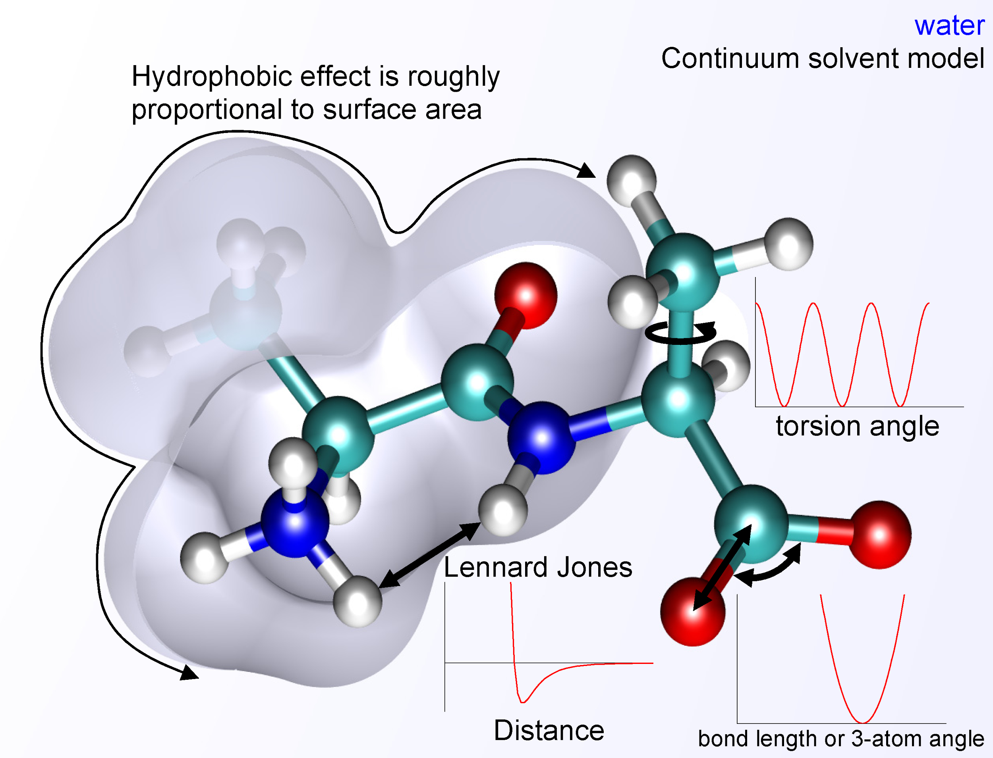
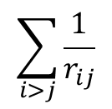
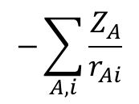
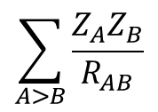
Molecular mechanics/Classical force field
The Electronic Schrödinger Equation (QM)
Electronic wave function
Electronic potential
energy
e
e
H
H

Slide 4
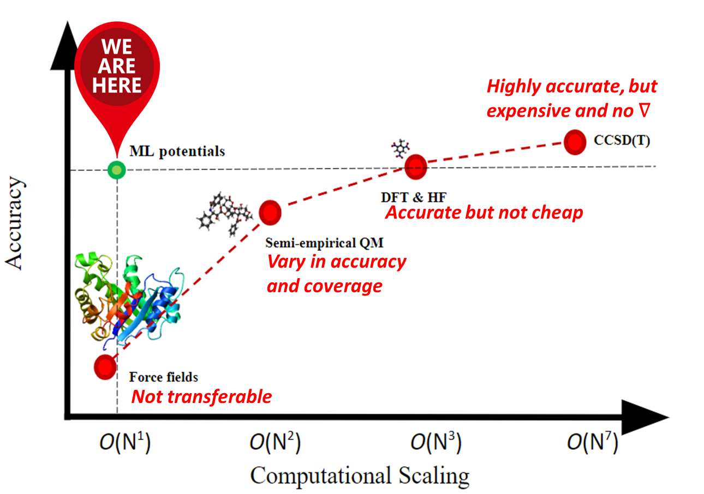
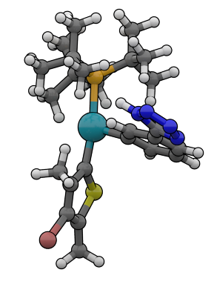
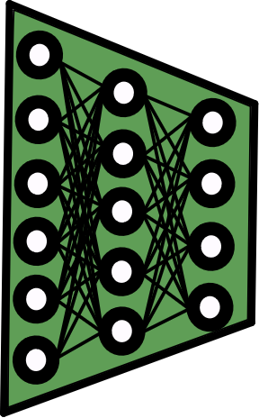

Machine Learned Interatomic Potential (MLIP) Motivation
(Spoiler alert!)
E=f(R_{vector})
Standard Geometry Optimization
(i.e., minimizing the atomic forces)
Forward Pass
Potential Energy
Atomic Forces
Backward Pass
Neural Network Interatomic Potential

Slide 5
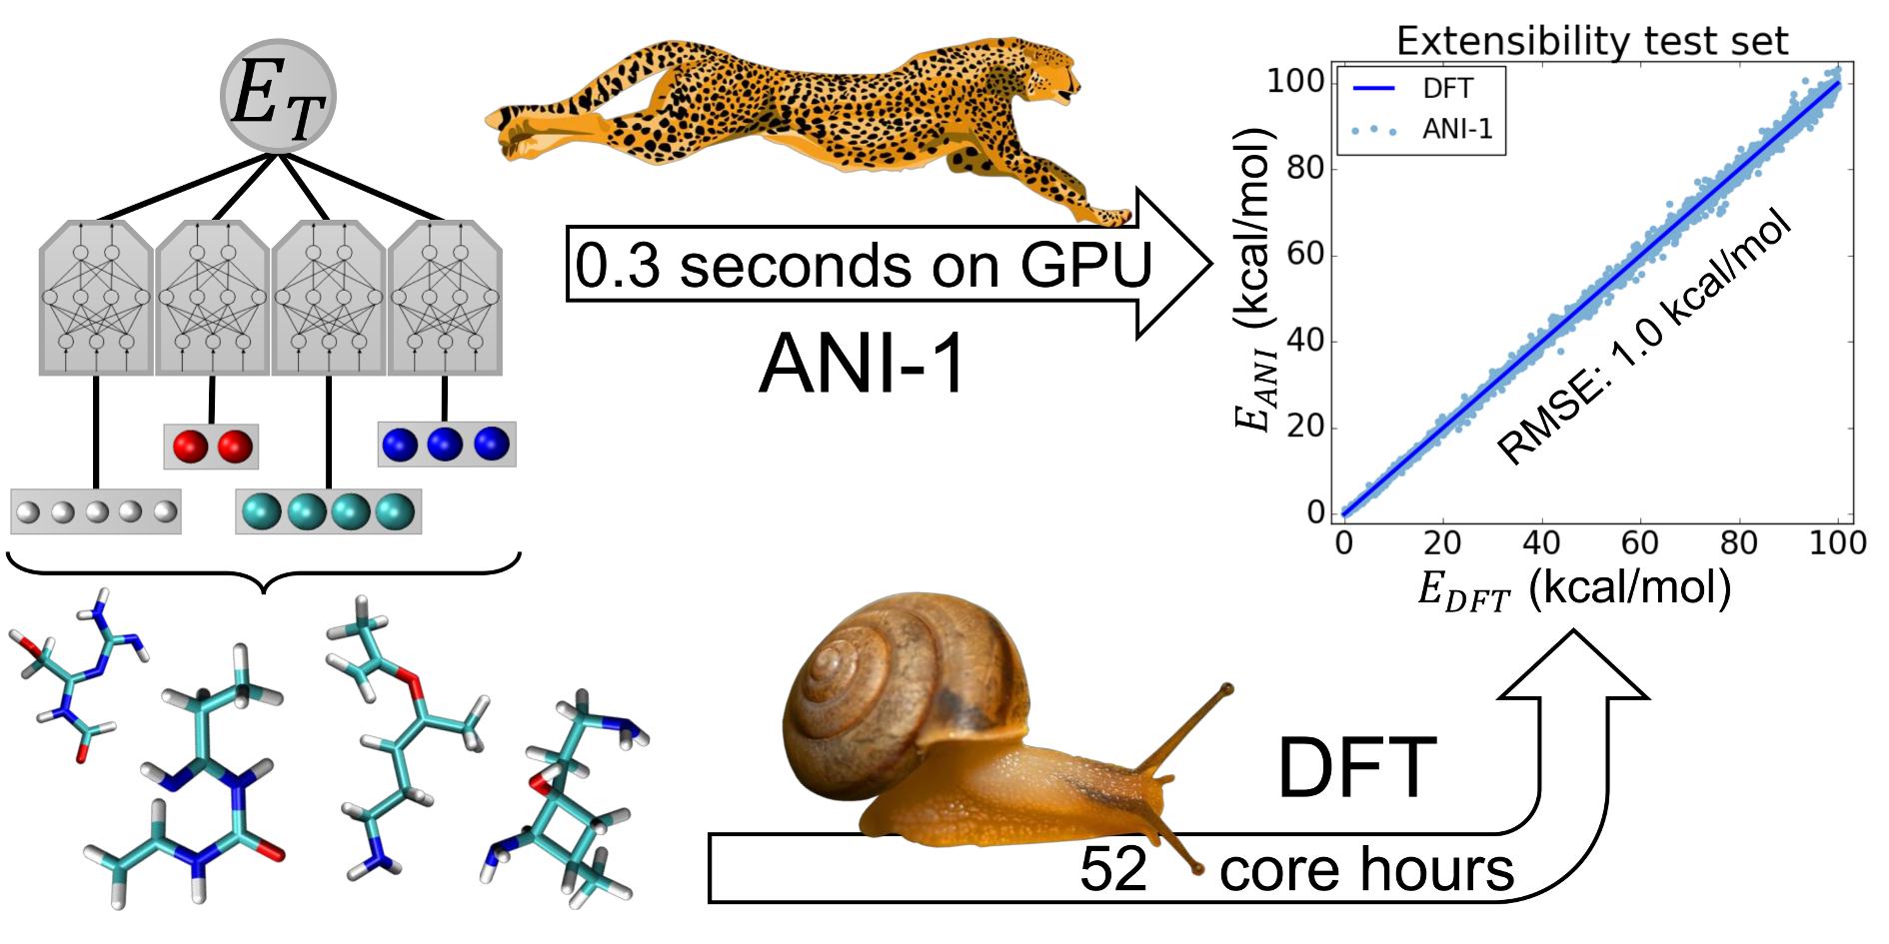
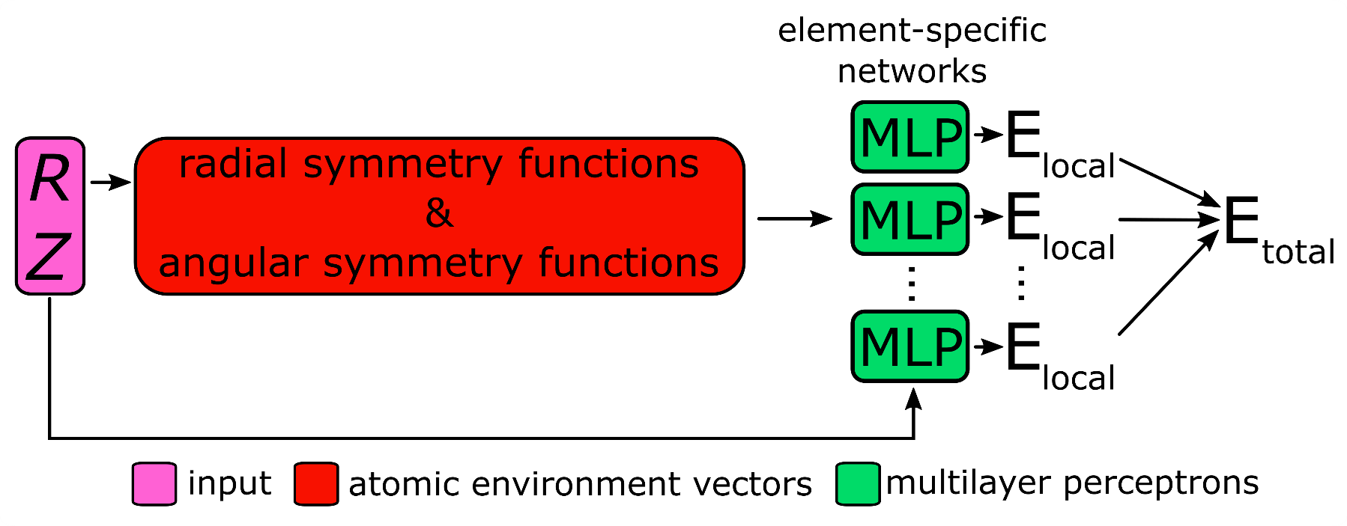
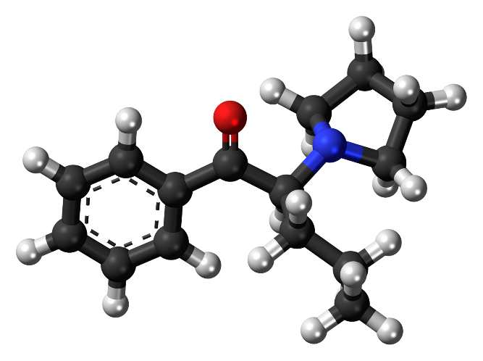

ANI Architecture
Local Atomic Environment: Justin Smith Symmetry Functions
5.0 Å
The Force is Strong with This One!
e.g., use element-dependent invariant symmetry functions
Justin Smith, O.I, and Adrian Roitberg. Chem. Sci. 8(4), 3192-3203, 2017.

Slide 6
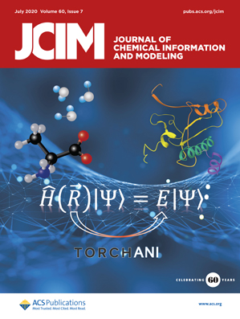
Current Features of ANI software
Currently available elements: CHNOSFCl
In progress: P, Br, I, B, Si, Se, Na…
More advanced model architectures with 14 elements
Two levels of theory:
ωB97M/Def2-TZVPP and
CCSD(T)*/CBS
Geo opt, analytic hessian, MD: NVE, NVT, NPT etc
Thermochemistry in harmonic and quasi-harmonic approximations
Accurate conformational search in gas and continuum dielectric
Full implementation of PBC, domain decomposition on multiple GPUs
Stress tensor and cell optimization
Methods
https://github.com/aiqm/torchani
Applications

Slide 7
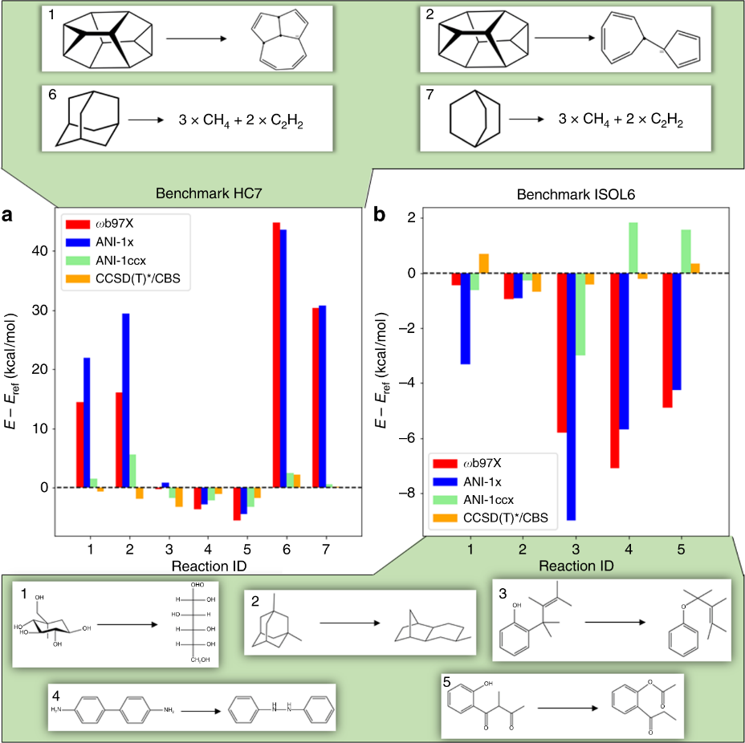
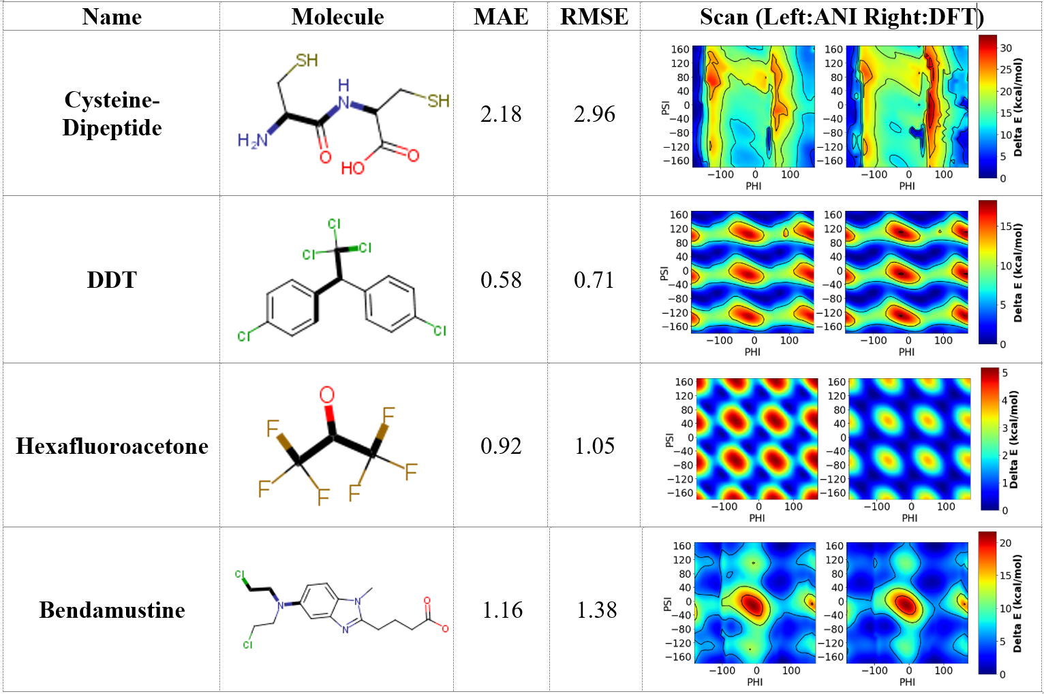
Fast but Accurate Property Predictions with ML
Geometry & Potential Energy Surface
Reaction Thermochemistry
Christian Devereux, Justin S. Smith, Kate K. Davis, Kipton Barros, Roman Zubatyuk, Olexandr Isayev, and Adrian E. Roitberg. Extending the Applicability of the ANI Deep Learning Molecular Potential to Sulfur and Halogens. Journal of Chemical Theory and Computation 2020 16 (7), 4192-4202 DOI: 10.1021/acs.jctc.0c00121
Smith, J.S., Nebgen, B.T., Zubatyuk, R. et al. Approaching coupled cluster accuracy with a general-purpose neural network potential through transfer learning. Nat Commun 10, 2903 (2019). https://doi.org/10.1038/s41467-019-10827-4

Slide 8
Uncertainty in stereochemistry is common in public datasets
Most databases record molecules as SMILES for simplicity
Stereo uncertainties occur due to many reasons, such as data mining method, conversion error…
Database | Size | Chiral molecules | Chiral molecules with unspecified stereo centers
Tautomer database | 1773 | 17% | 77%
DrugBank | 7633 | 58% | 19%
ChEMBL | 2.1M | 44% | 52.5%
Notes:
Actually, most databases record molecules as SMILES for simplicity. SMILES is the abbreviation for simplified molecular-input line entry system. It encodes a molecule as a line of text.
For example, here is a table showing the statistics in three databases. You can see that all of them contains a considerable amount of chiral molecules. However, a large precent of the chiral molecules contains unspecified stereo centers.
There are multiple reasons for the stereo uncertainties: …

Slide 9
Example of missing stereo information in SMILES

Slide 10
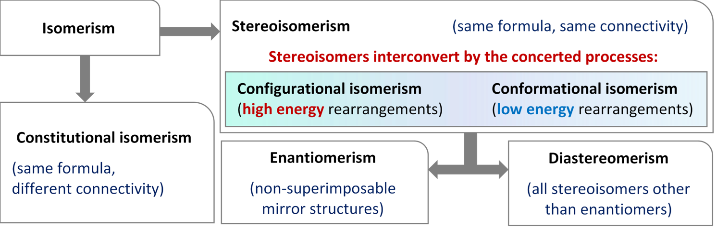
Heavy duty and limited power
Recovering 3D structures from SMILES needs to enumerate both the configurational space and conformational space
Conventional QM methods are expensive at molecular geometry optimization
Notes:
Due to the stereo uncertainties, recovering 3D structures from SMILES is not trival. Let’s briefly review the isomerism. Given a SMILES with different stereo-uncertainties, we at least need to consider the configurational isomerism and conformational isomerism.
Recovering 3D structures from SMILES needs to enumerate both the stereoisomer space and conformer space, which is a huge. In fact, the space is infinite if we consider the rotation of a bond as a continuous process. Getting low energy 3D structure requreis to evalueate all the possible conformers.
However, Conventional QM/MM methods are expensive at molecular geometry optimization. It’s a few hours to optimize a single structure. It could take a few days to optimize and evaluate all possible conformers for a single SMILES.

Slide 11
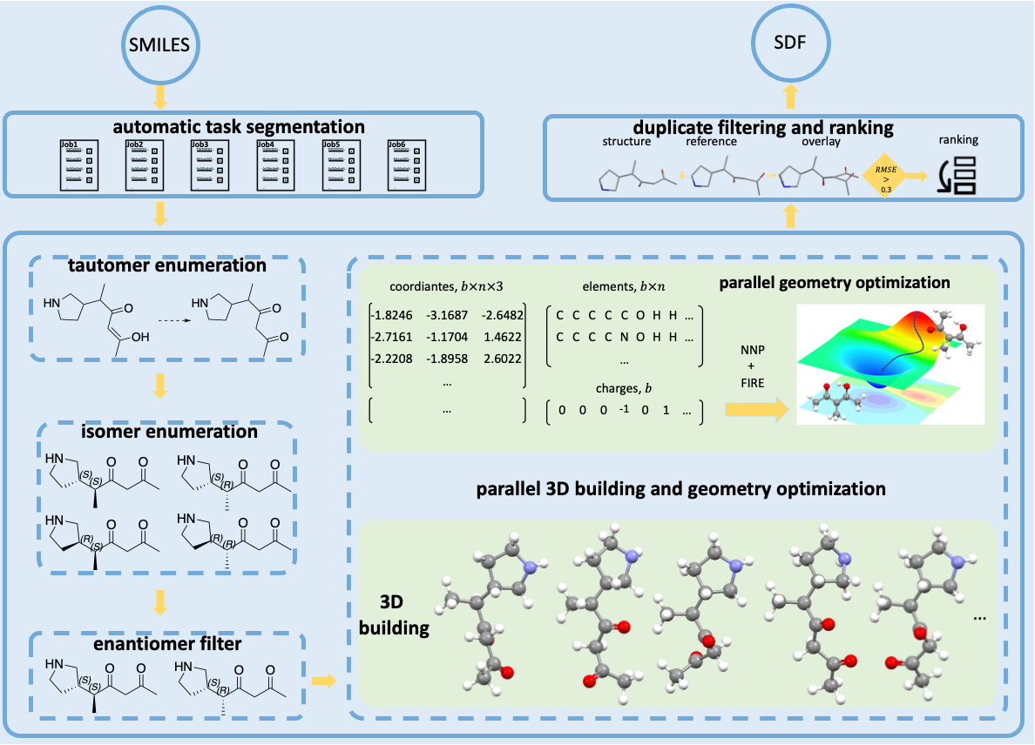
Auto3D Package
Input: SMILES
Output: Optimized conformers and energies
Isomer engine: RDKit/OMEGA
Optimizing engine: ANI-2x/AIMNET/ANI-2xt
Key features:
Accurate NNPs
Highly parallel on GPUs
Run as a Python
library, CLI, yaml
Liu, Z.; Zubatiuk, T.; Roitberg, A.; Isayev, O. J. Chem. Info. Model. 2022, 62(22), 5373
Notes:
The development of NNPs makes Auto3D possible. This is what happened behind the Auto3D package. It takes SMILES as the input, returns the optimized low-energy 3D conformers as the output in the SDF format.
Auto3D detects your system memory, so your SMILES file can be automatically spited into several smaller jobs if it’s too large.
Each small job will go through this box.
There is a optional tautomer enumeration step.
Then we enumerate all unspecified stereo centers in the SMILES, including chiral atoms on the ring and chain, double bonds. The specified stereo centers will remain untached.
Then we filter out one of the enantiomers, because enantiomers have the same energy. We only care about energy here. Filtering them enantiomers reduces the time for next steps.
The green part is the key.
First, we need to build all possible 3D structures for the input SMIELS. We can choose either RDKit or Omega for this. We remove similar conformers in this step, using RMSD, root mean standard deviation of atomic positions of two conformers.
All these conformers are concatenated together for geometry optimization. We have three matrixes, one contains the coordinates, one contains the elements, the other one continas the molecular charges. Note that a matrix should have the same dimension, but molecules naturally have different sizes, so we pad smaller molecules with dummy atoms to make all molecules have the size when represented in matrix. These matrixes will be passed to our NNPs for geometry optimization. This process can be run on CPU or GPU. Let me emphasis, we are optimize thousands of conformers at the same time. This is the key for the efficiency of Auto3D. The optimizing NNPs can be either ANI-2x, AIMNET and ANI-2xt. The fist two have detailed descriptions in literature, I will focus on ANI-2xt for today.
This 3D building process and parallel geometry optimization process are also parralel. This brings speedup if there are multiple smaller jobs.
Auto3D is independent of OS. It’s highly parallel for speed, and it contains accurate NNPs.

Slide 12
CLI
–k top-k structures for each molecule –window window (kcal/mol) from the lowest energy Optional arguments: –tauto_engine ‘rdkit’ or ‘oechem’.
–isomer_engine conformer generator either ‘rdkit’ or ‘omega’ –enumerate_isomer True/False –use_gpu True/False –optimizing_engine AIMNet2 by default, ANI1x/ANI-2x or any custom MLIP in PyTorch
…

Slide 13
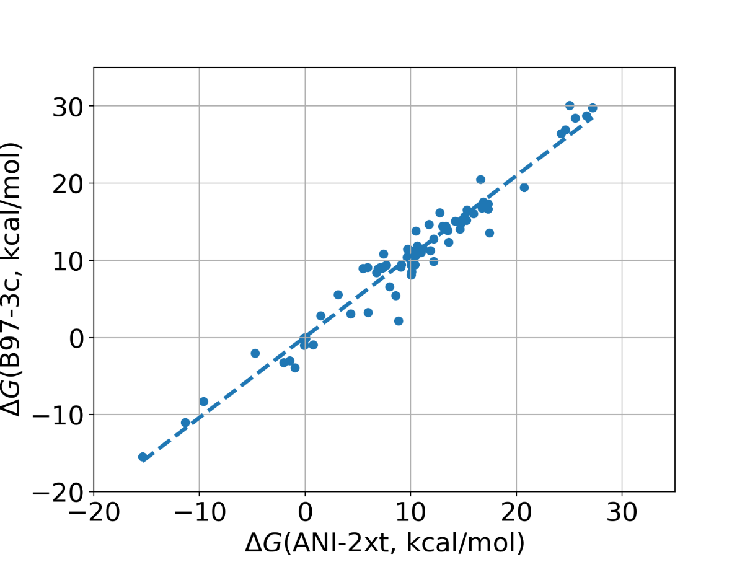
An example from scratch: Gibbs free energy of tautomerization reactions
R²: 0.95
MAE: 1.48 kcal/mol
81 SMILES pairs
Obtain 3D structure with Auto3D
Calculate Gibbs free energies with ANI-2xt and B97-3c, respectively.
$$∆G_{taut}^{gas}=∆E_{taut}^{el}+∆E\left(ZPE\right)+∆E^{t}−T∆S$$
Liu, Z.; Zubatiuk, T.; Roitberg, A.; Isayev, O. J. Chem. Info. Model. 2022, 62(22), 5373

Slide 14

Current user base
Academic labs
Big pharmaceutical companies
Chemical Industry
Drug discovery startups
Installation: pip install Auto3D
https://github.com/isayevlab/Auto3D_pkg
Notes:
screen short from Pat Walter: https://youtube.com/clip/UgkxD4jOJBSOkAIsl9NVnfroyYrSj9N9_SzD

Slide 15
Roadmap: Auto3D 2025 and beyond
Speedups and tweaks – at least 10x performance improvement with clever batching etc.
New AIMNet2 models with continuum solvent CPCM/COSMO
pKa and protonation functionality either with ML or AIMNet2
Fully generative low energy conformer generation without explicit enumeration!

Slide 16
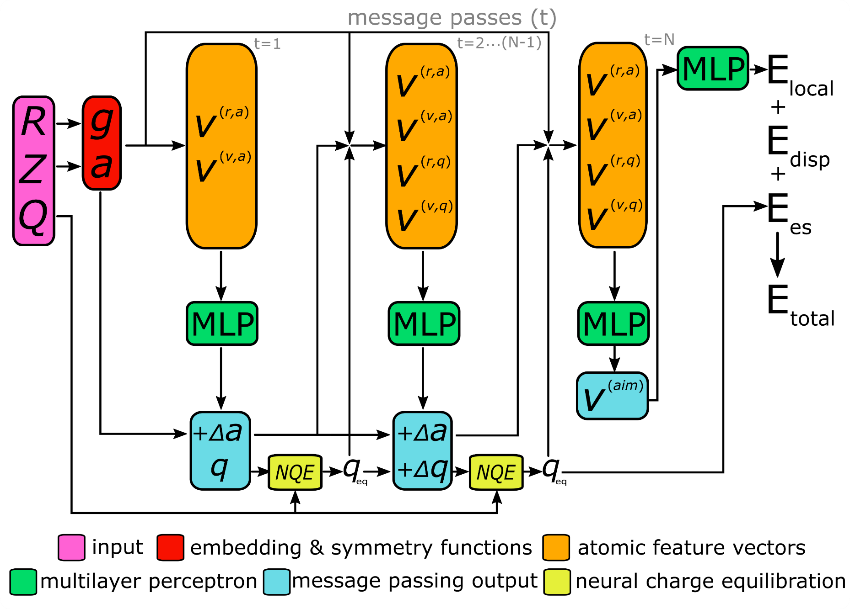
2024: AIMNet2
The 2nd Generation Atoms-in-Molecules Model
Pre-trained Models and Calculators Available: https://github.com/isayevlab/aimnetcentral

Slide 17
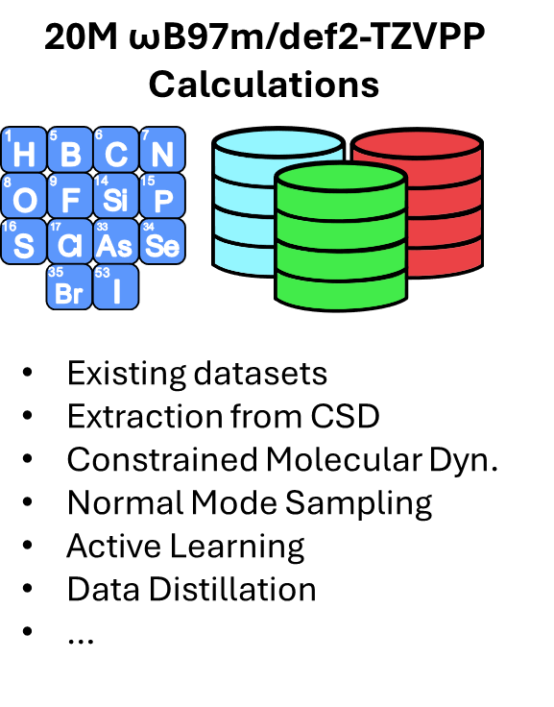
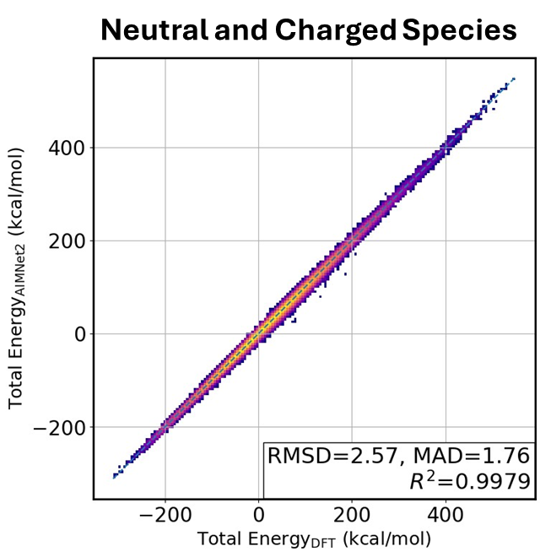
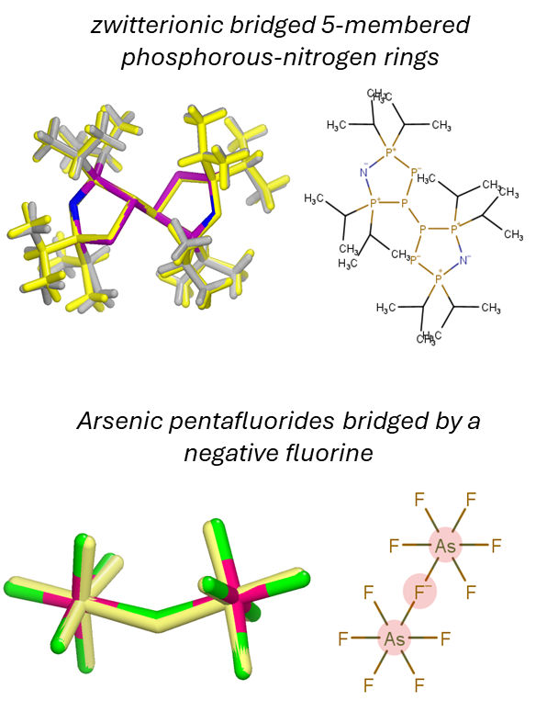
The 2nd Generation Atoms-in-Molecules ML Potential
AIMNet2 is generalized potential with chemical space coverage of common non-metal and halogen elements with ~hybrid DFT accuracy
Pre-trained Models and Calculators Available: https://github.com/isayevlab/aimnetcentral
Anstine D, Zubatyuk R, Isayev O. AIMNet2: A Neural Network Potential to Meet your Neutral, Charged, Organic, and Elemental-Organic Needs. ChemRxiv.; 2023; DOI: 10.26434/chemrxiv-2023-296ch

Slide 18
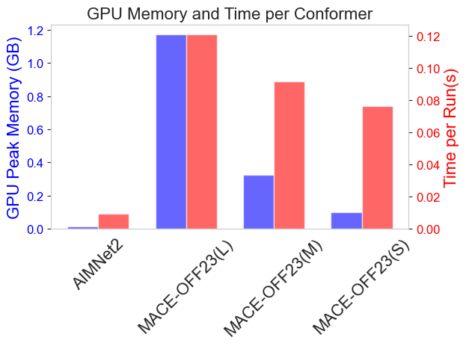
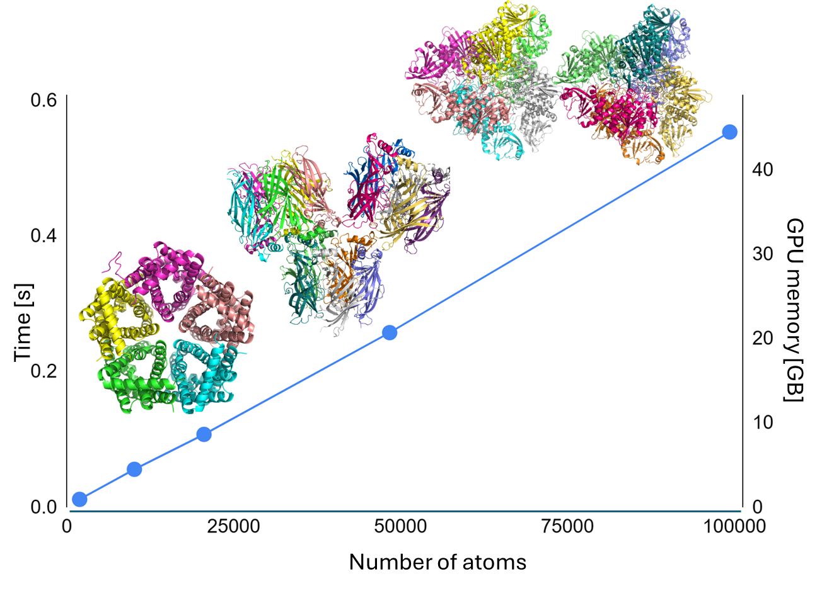
AIMNet2 computational efficiency
Single-point energy of macrocyclic peptide
Protein energy & gradient evaluation
Benchmarks performed on a Nvidia H100 (80GB VRAM)
LBFGS optimizer in ASE has overhead of 4-5% beyond forces evaluation with AIMNet2.
Benchmarks performed on Nvidia NVIDIA V100 GPUs (32 GB SMX2).

Slide 19
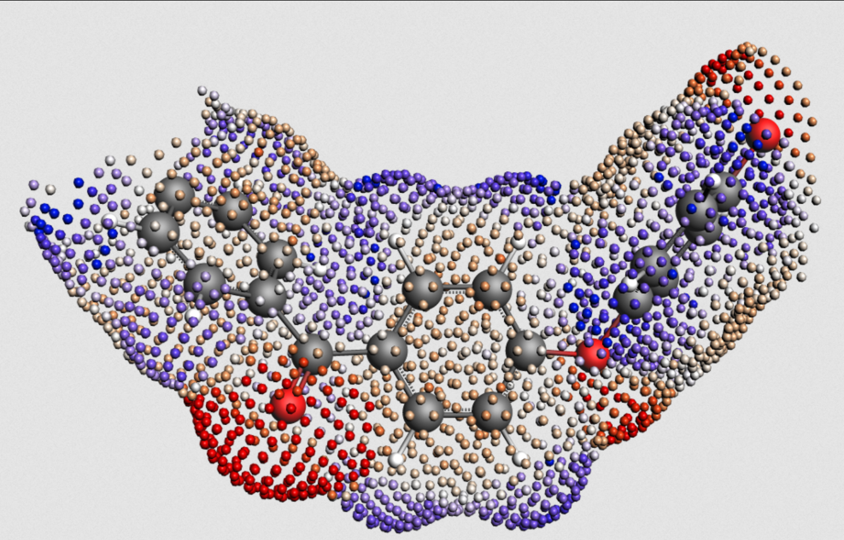
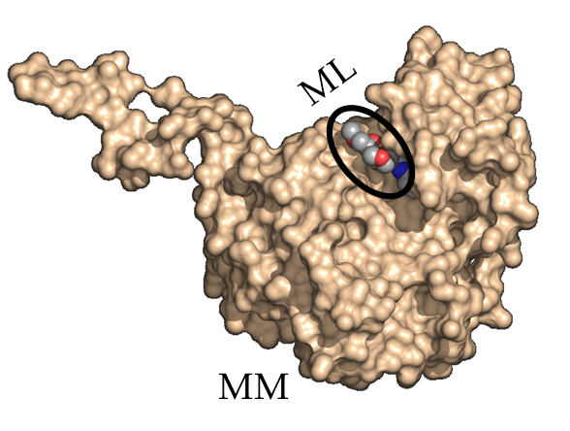
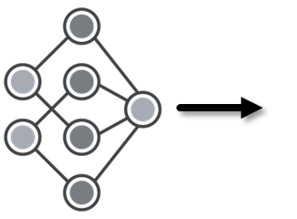
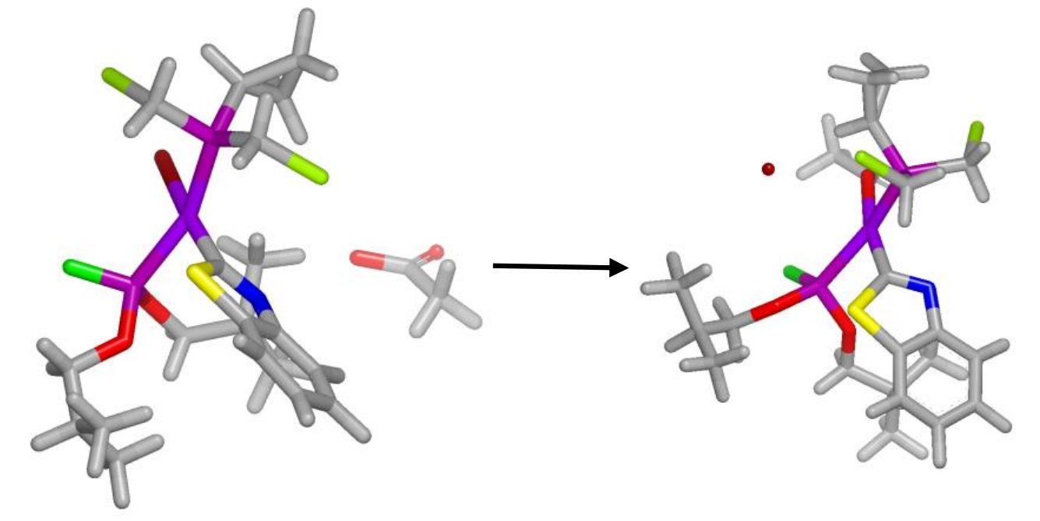
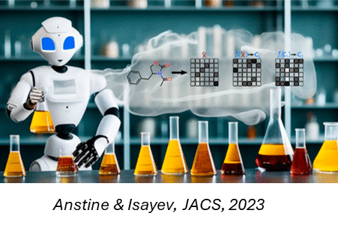
AIMNet2 Foundation Model: Enabling Diverse Application
AIMNet2-COSMO-SAC/ RS
Machine Learning / Molecular Mechanics Simulations
Pd Catalyzed Reactions
Generative Modeling

Slide 20
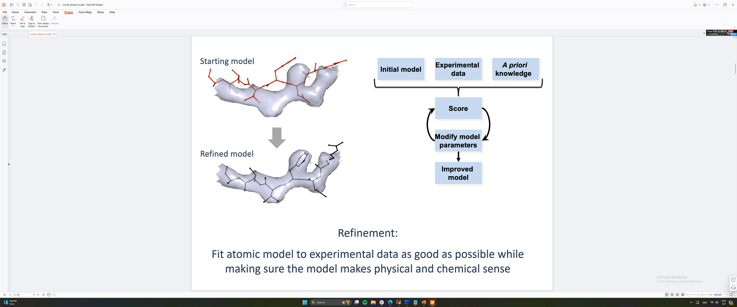
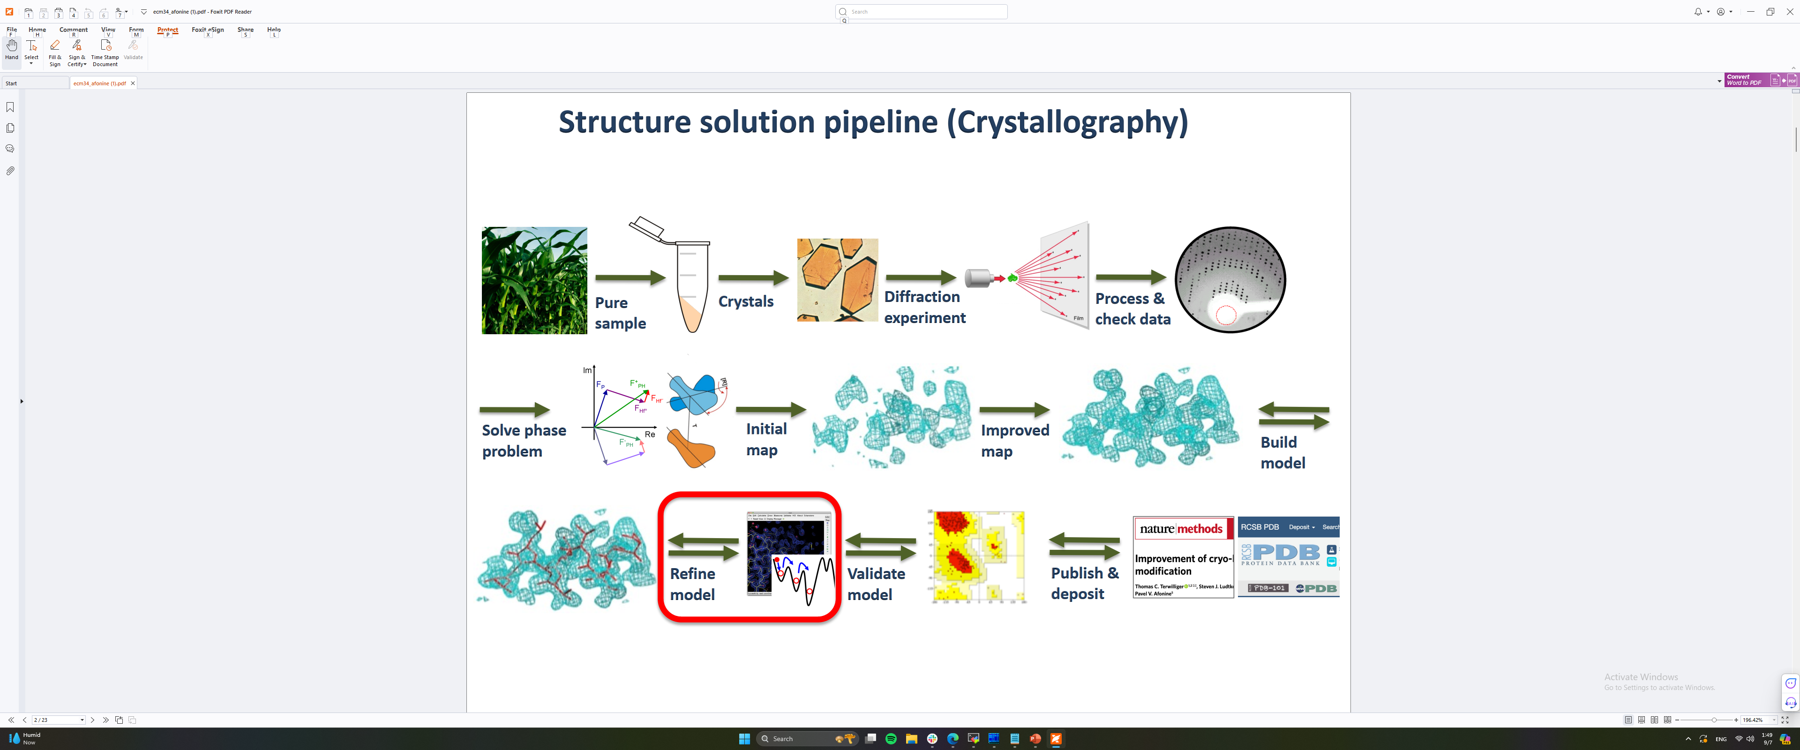


Refinement of protein crystal structure with ML
Priori knowledge
Optimization process of fitting structural parameters to experimental data
Fit atomic model to experimental data as good as possible while making sure the model makes physical and chemical sense
QM computations
https://github.com/qrefine/
R. Zubatyuk, et al. AQuaRef: Machine learning accelerated quantum refinement of protein structures. BioRxiv 2024.07.21.604493; DOI: https://doi.org/10.1101/2024.07.21.604493

Slide 21
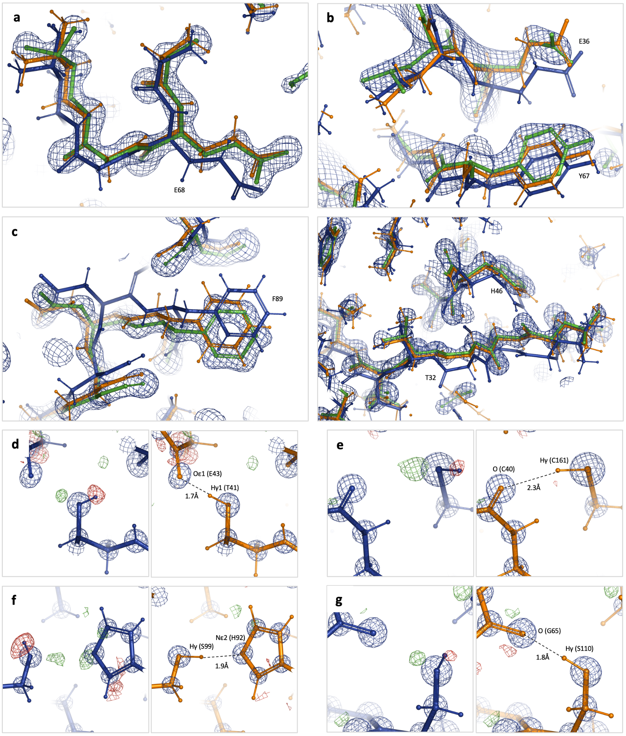
Default Phenix Refinement vs AQuaRef
Close-up showing models refined with standard restraints (blue) and AQuaRef restraints (orange) superposed onto their higher-resolution homologous models (green) with their corresponding 2mFo-DFc Fourier maps contoured at 2σ.
R. Zubatyuk, et al. AQuaRef: Machine learning accelerated quantum refinement of protein structures. BioRxiv 2024.07.21.604493; DOI: https://doi.org/10.1101/2024.07.21.604493

Slide 22
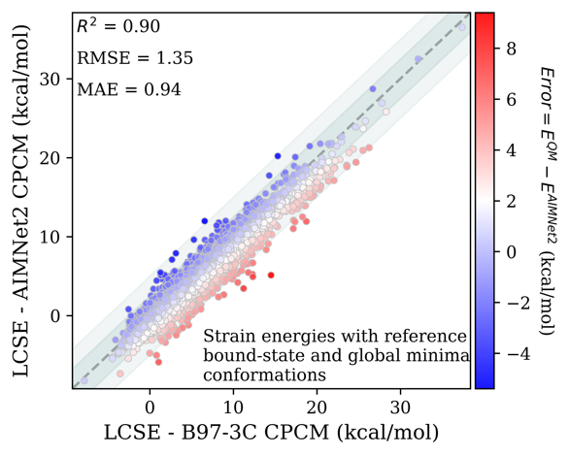
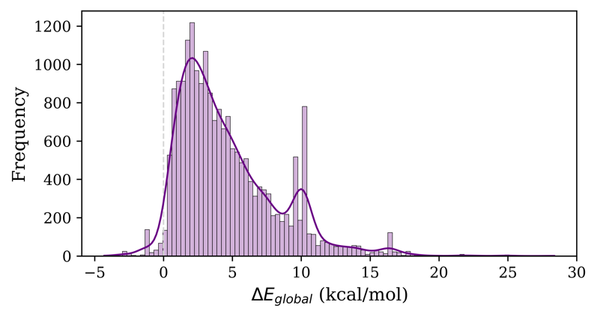
AIMNet2-CPCM and Auto3D benchmark for ligand strain energy and global conformers from PDB
Energy difference between the reference global conformers and conformers obtained with AIMNet2-CPCM model and Auto3D
Ligand conformational strain energies computed with reference global and bound conformers
H. Gockan, O.I. et al. To appear, 2025

Slide 23
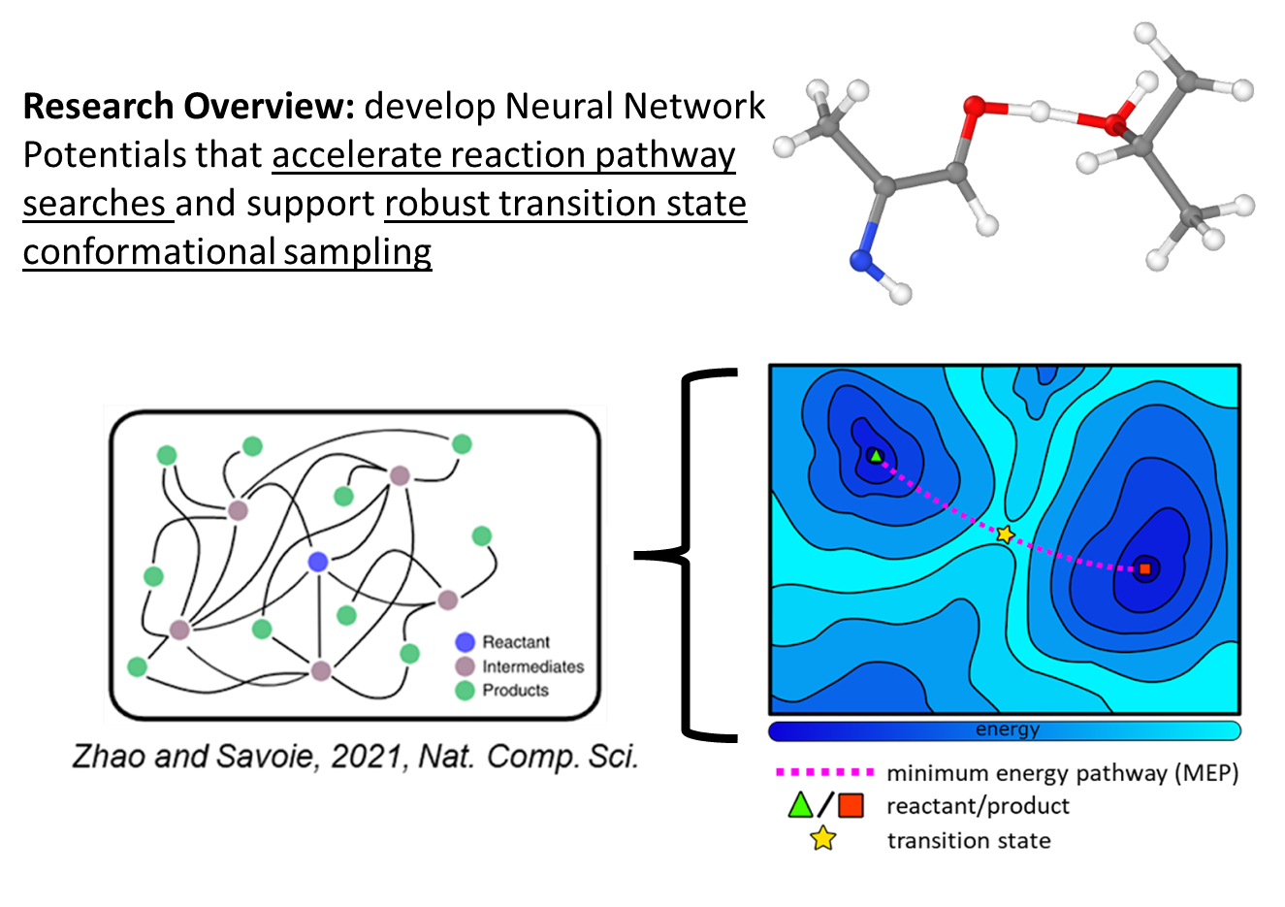
Roadmap: AIMNet2 for Transition State Chemistry!

Slide 24
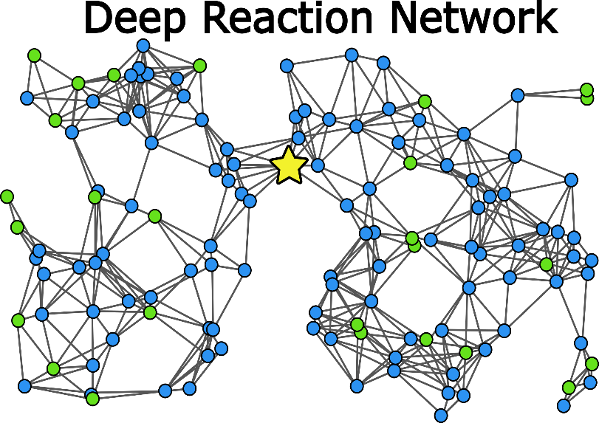
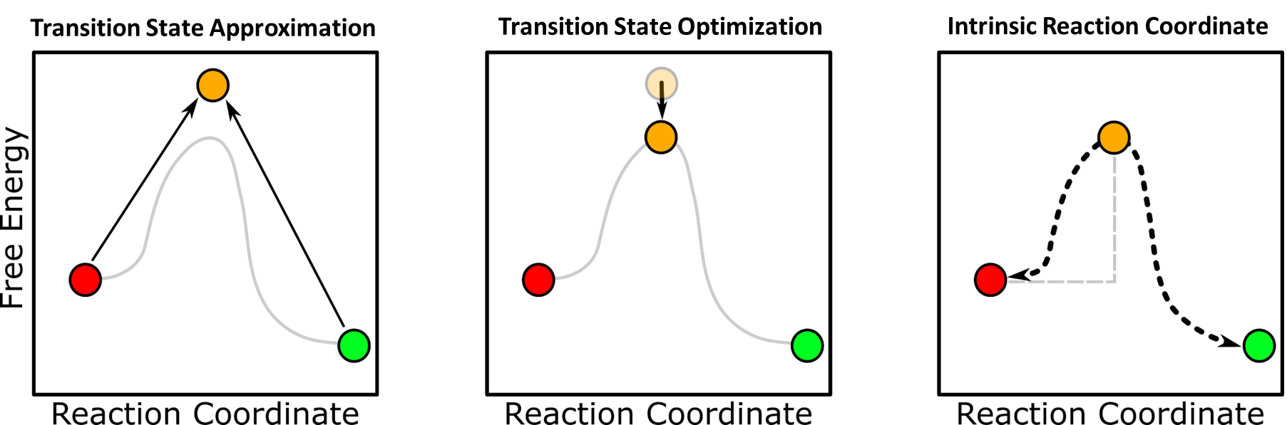
The Challenge of Computational Mechanistic Modeling
Tasks such as synthesis planning or reaction engineering can require traversal of deep reaction networks, which is laborious with QM methods.
Goal: Carry out mechanistic modeling tasks, e.g., transition optimization, efficiently on ML potential energy surfaces with minimal sacrifices to accuracy.
Synthesis Planning
Stressor-Specific Deconstruction
Total Synthesis
Biochemical Pathways
…
approximate time required per reaction with DFT: hour(s) – several days
Plugins: ASE, Sisyphus, Sella (coming soon)
contact: danstine@andrew.cmu.edu

Slide 25
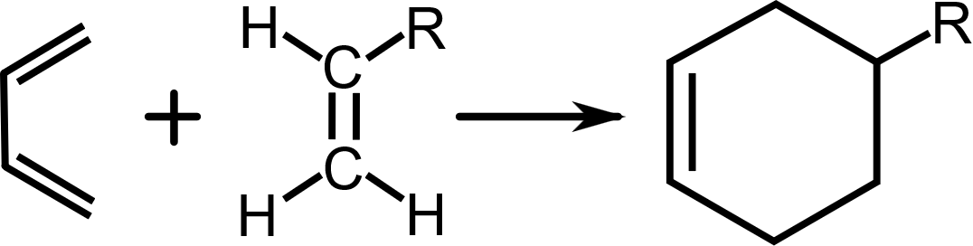
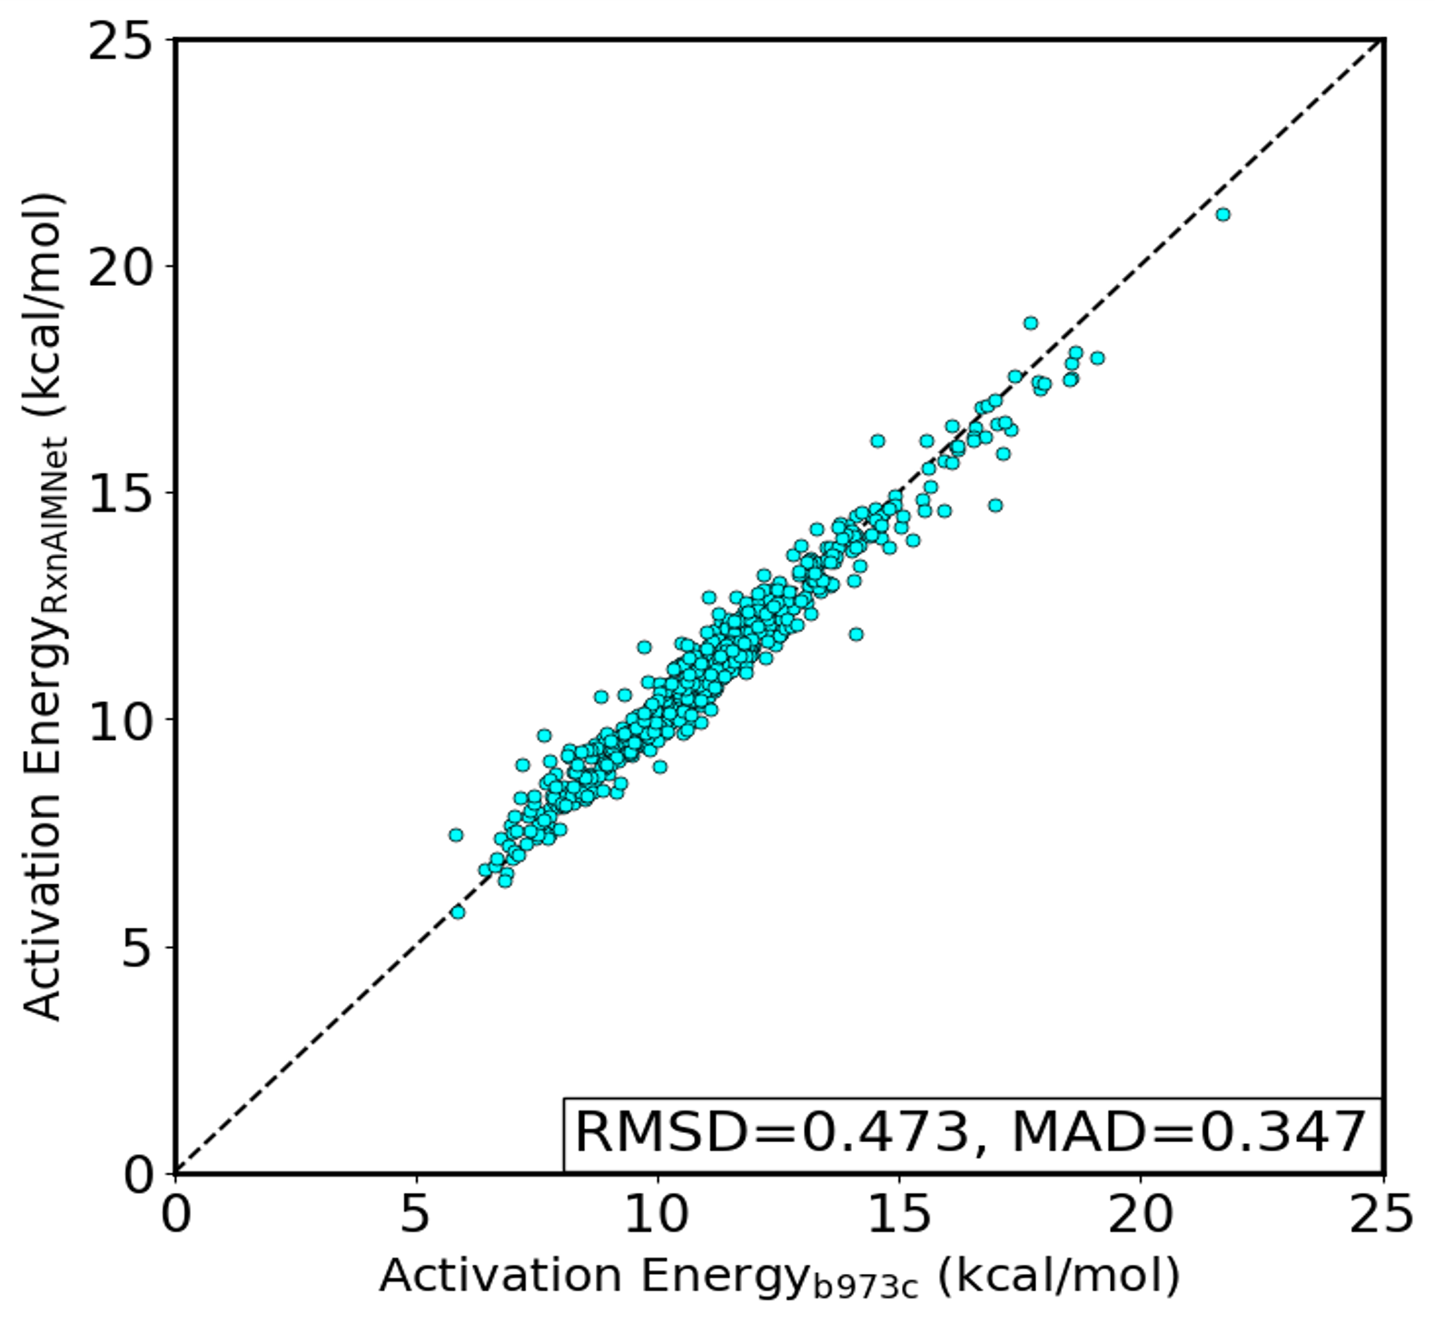
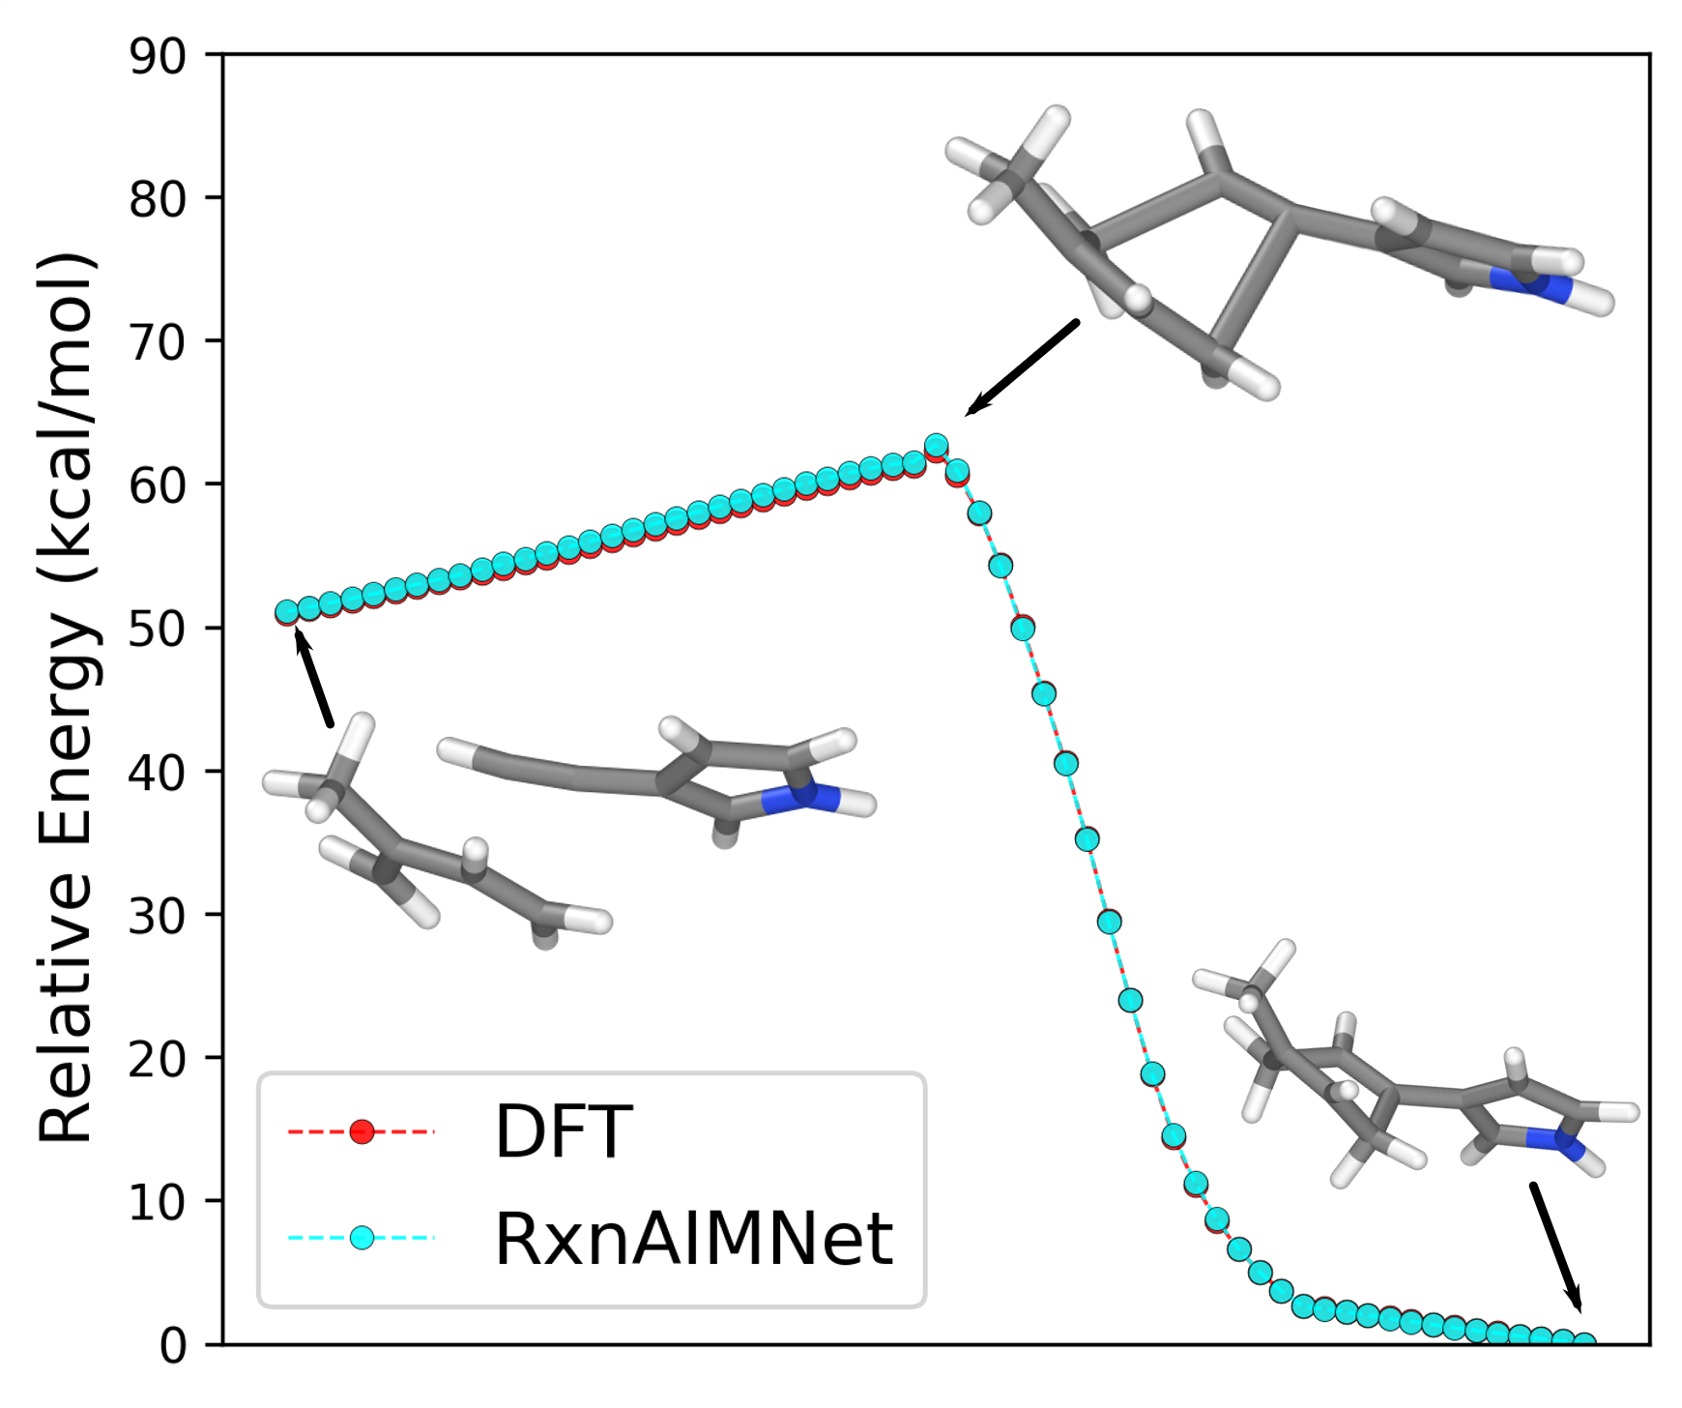
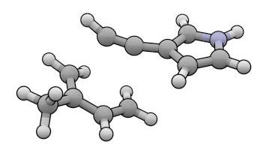
RxnAIMNet Enables Accurate Mechanistic Study
RxnAIMNet characterizes Diels-Alder thermochemistry within 0.5 kcal mol⁻¹ despite only being trained on simple bond-breaking & bond-forming operations.
[4+2]-cycloaddition
650 Diels-Alder reactions
Diene
Dienophile
Unsaturated Ring
*accurately distinguishes endo vs. exo selectivity and regioselectivity
contact: danstine@andrew.cmu.edu

Slide 26
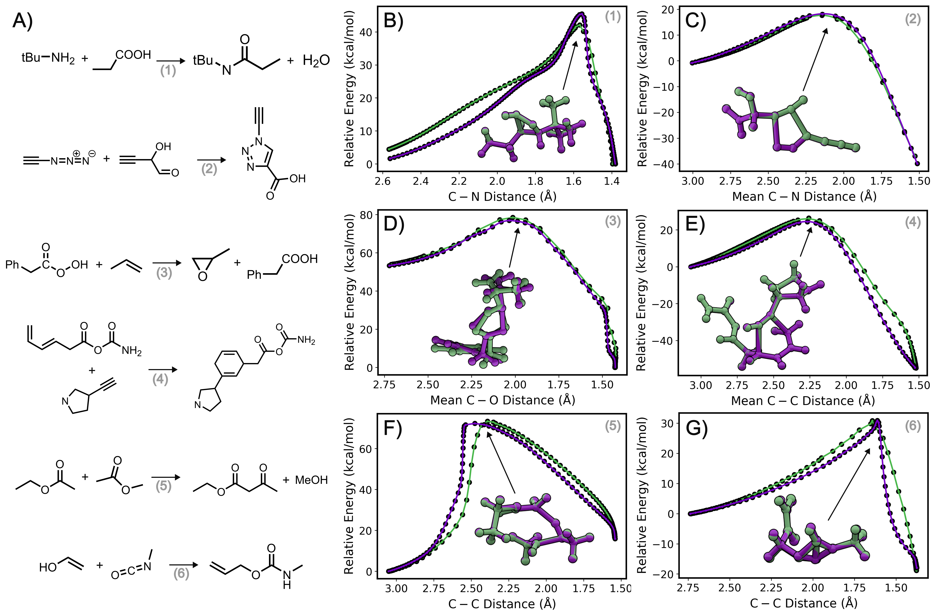

One NNP, Many Reaction Mechanisms without Retraining
suggestions
RxnAIMNet has been tested on Diels-Alder, triazole formation (click chemistry), combustion, tautomerization, hydrogen transfer, esterification, aldehyde and ketone formation, metathesis, ring-closing and ring-opening, amine protection-deprotection, …
Several Collaborative Application Projects using RxnAIMNet Coming Soon!

Slide 27
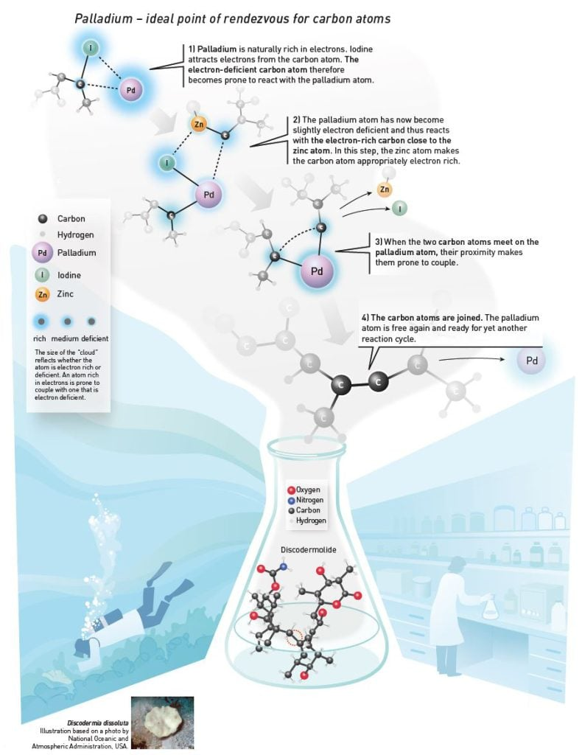
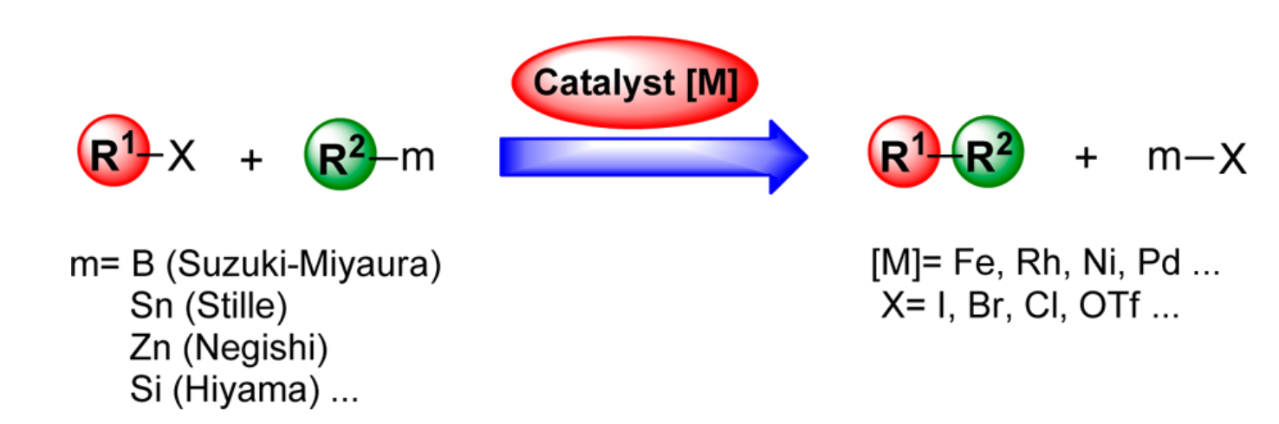
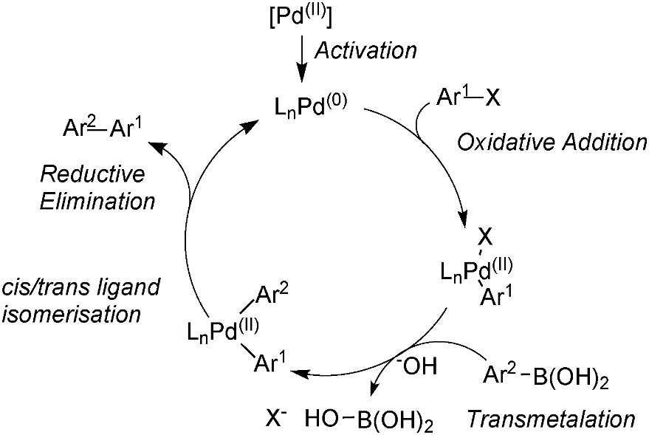
AIMNet2-Pd: Pd-catalyzed C-C cross-coupling reaction
AIMNet2-Pd is the 1st MLIP with broad applicability to reactive Pd-based metal-organic molecules
Anstine D, Zubatyuk R, et al. Transferable Machine Learning Interatomic Potential for Pd-Catalyzed Cross-Coupling Reactions. ChemRxiv. 2025; doi:10.26434/chemrxiv-2025-n36r6

Slide 28
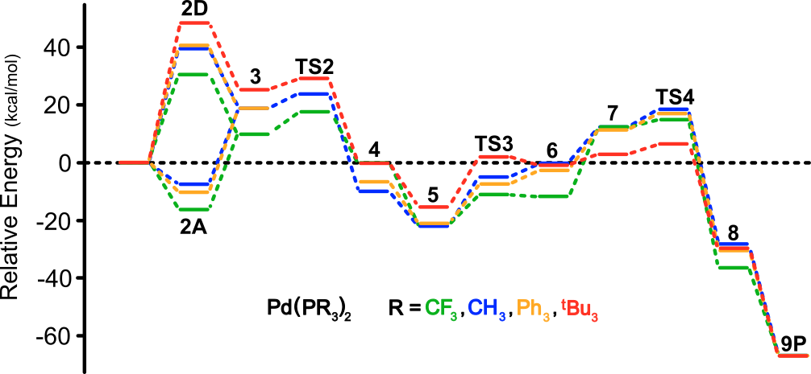
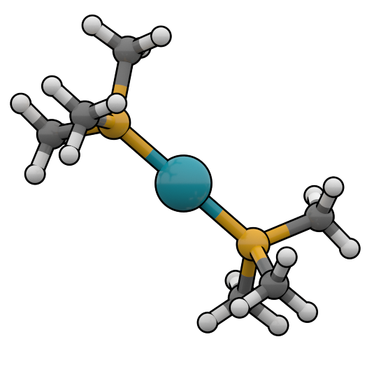

AIMNet2-Pd for Pd-based Homogenous Catalysis
The homogenous catalyst market in the U.S. is a multi billion-dollar industry¹.
Identifying selective, fast, high-yielding catalytic pathways can be transformative to, for example, pharmaceuticals, polymer synthesis, environmental science, petroleum engineering…
carbon-carbon bond formation via Pd-based molecular catalysts
ligands
Anstine D, Zubatyuk R, et al. Transferable Machine Learning Interatomic Potential for Pd-Catalyzed Cross-Coupling Reactions. ChemRxiv. 2025; doi:10.26434/chemrxiv-2025-n36r6
¹ https://www.grandviewresearch.com/industry-analysis/homogeneous-catalyst-market-report
contact: danstine@andrew.cmu.edu

Slide 29


Computational Ligand Design for Molecular Catalysts
Design of molecular catalysts often relies on codified design principles, empirical experience of expert chemists, and fundamental reaction understanding.
Anstine D, Zubatyuk R, et al. Transferable Machine Learning Interatomic Potential for Pd-Catalyzed Cross-Coupling Reactions. ChemRxiv. 2025; doi:10.26434/chemrxiv-2025-n36r6
Martin and Buchwald, Acc. Chem. Res., 2008, 41(11), 1461-1473.
contact: danstine@andrew.cmu.edu

Slide 30

Accurate Prediction of Suzuki-Miyaura Geometries
AIMNet2-Pd accurately characterizes (< 0.2 Å) the chemical geometries across the entire Suzuki-Miyaura catalytic cycle.
*Running Sequentially on a CPU → minutes.
**Improved efficiency of post-DFT calculations.
Anstine D, Zubatyuk R, et al. Transferable Machine Learning Interatomic Potential for Pd-Catalyzed Cross-Coupling Reactions. ChemRxiv. 2025; doi:10.26434/chemrxiv-2025-n36r6
contact: danstine@andrew.cmu.edu

Slide 31







Radical Reaction Profiles
Silylated Benzopinacol
+
Dibenzoyl Peroxide
Notes:
What is uncertainty quantification?

Slide 32





Industrial Radical Polymerization Reactions
2-methylene-1,3-dioxepane
S = 2
Reactant
Product
RMSD: 0.139 Å
RMSD: 0.231 Å
Transition State
RMSD: 0.140 Å
Nesvadba, P. Radical Polymerization in Industry. https://doi.org/10.1002/9781119953678.rad080
Notes:
Can we calculate RMSD without Hydrogen. How is it hard to compare normalized IRC

Slide 33






Use the AIMNet2: Anstine D, Zubatyuk R, Isayev O. ChemRxiv Preprint. 2023; https://doi.org/10.26434/chemrxiv-2023-296ch AIMNet2 implementation in Pytorch Available at: https://github.com/isayevlab/aimnetcentral Plugins: ASE, LAMMPS, OpenMM, SCM-ADF… AIMNet2 Dataset: https://doi.org/10.1184/R1/27629937.v2
Used in Government labs, companies etc.

